Slide 1
NovaMed-Solutions
Team Lyra

Slide 2
Project Background
NovaMed Solutions, established in 2022, is a prominent pharmaceutical distributor offering prescription medicines online and through pharmacies.
The company serves a diverse healthcare sector but faces challenges in demand forecasting, stock management, and customer engagement, impacting its operations.
With large data silos of sales records, customer information, and drug data, NovaMed struggles to consolidate sales performance, manage inventory, and identify market opportunities.
Analysing comprehensive sales data, including revenue and customer demographics, aims to enhance business strategies and streamline operations through data-driven decisions.

Slide 3

Key Insights
Top/Bottom Analysis: This involves tracking overall sales metrics, including revenue, profit, and cost of goods sold (COGS).
Month-over-Month Comparison: An analysis comparing the performance of drugs in terms of revenue and profit with the previous month.
Customer Analysis: An assessment of how customer segments, such as age group, purchasing category, and gender, influence revenue, profit, and sales.
Geographical Analysis: An examination of the key revenue sources based on customers' geographical locations, including countries.

Slide 4
Data Model
NovaMed-Solutions has a database structure that includes four tables: the Sales Fact Table, Customer Dimension, Drug Lookup Dimension, and Calendar Dimension. The Sales Fact Table contains 16,314 records and is frequently updated.
Sales Fact Table: This table has a primary key (SaleID) and foreign keys (DrugID, CustomerID, and Sale Date). It includes columns for Units Sold, Buyer Type, and calculated columns for Revenue, Profit, and Cost of Goods Sold.
Customer Dimension: This table contains customer information, including First Name, Last Name, Age, and Gender. It also features a calculated column for Age Group, which helps facilitate better analysis.
Drug Lookup Dimension: This table holds details about drugs, such as Regulatory Compliance ID, Drug Name, Unit Sales Price, Cost of Production, and what conditions the drugs treat. Its numerical columns are used to create calculated columns in the Sales Fact Table using the RELATED keyword.
Calendar Dimension: This table features a custom calendar aligned with NovaMed’s business periods. It includes the Year, Month Name, Date and month Number, which assists in month-over-month analysis.

Slide 5
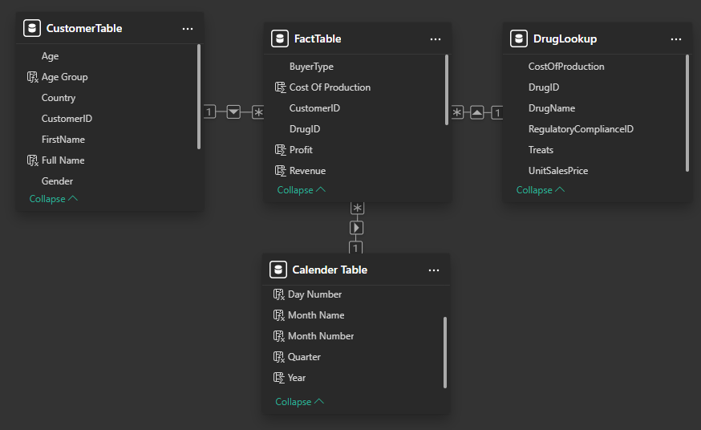
Entity Relationship
The model is a star model with the fact table at the centre, with connections to the dim tables using their primary keys to create a relationship.
All the dim tables are a 1-to-many relationship with the fact table.

Slide 6

Data Cleaning & Transformation
Removing duplicate IDs and replacing errors with placeholder values.
Converting column types into the correct data type, e.g. MM-DD-YYYY, to short date using Locale.
Grouping customer ages from raw numeric values into age segments.
Creating relationships by establishing 1-to-many links between the dimension tables and the fact table.
Improving time intelligence by using both the month name and the month number.

Slide 7
Executive Summary
- The profit margin has been high, averaging 81.97%.
In 2023, revenue peaked at $5.80 million in July, while revenues for other years never reached $1 million in any month.
The combined revenue of the bottom five drugs is less than the revenue of any individual drug on the top five list.
Top-selling drugs such as Doxycycline and Ezetimibe have individual revenues exceeding $3 million.
Canada and Australia contribute the largest share of revenue, with the majority of customers being seniors.
Although most of the drugs were purchased directly by end users, the sellers' revenue was 7.4 times greater than the revenue from end users.

Slide 8
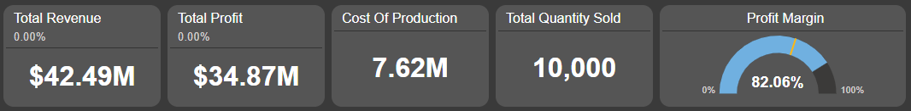
Executive Summary
The profit margin has remained high, averaging 82.06% over the years.
In 2023, revenue peaked at $61.68 million, while revenues for subsequent years, such as 2025, only reached $2.88 million.
Doxycycline was the highest-selling drug, generating a revenue of $3.53 million and a profit of $3.36 million, resulting in a profit margin of 95.10%.
Other top-selling drugs included Ergocalciferol, Lisinopril, Clonazepam, and Ezetimibe, each making over $3 million in revenue individually.
The bottom five underperforming drugs barely reached $1 million in revenue, with Metformin having the highest at $ 607.27 thousand and Warfarin having the lowest at $229.25 thousand.
The majority of the bottom five drugs exhibited low profit margins below 35%, with only Prednisone achieving a profit margin of 77.85%.

Slide 9
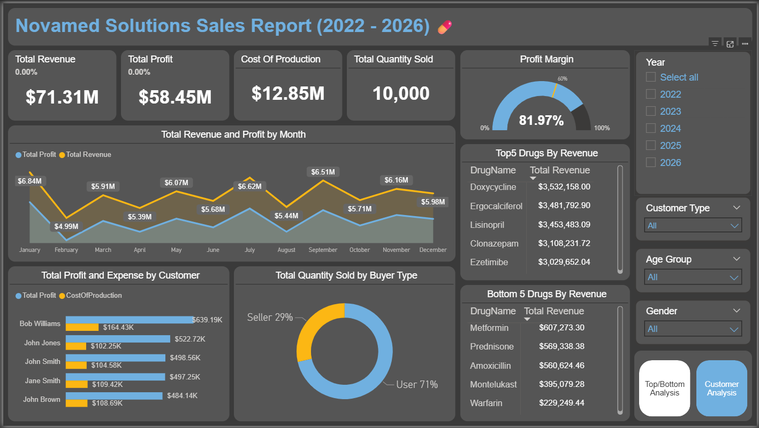
Top/Bottom Analysis Dashboard

Slide 10
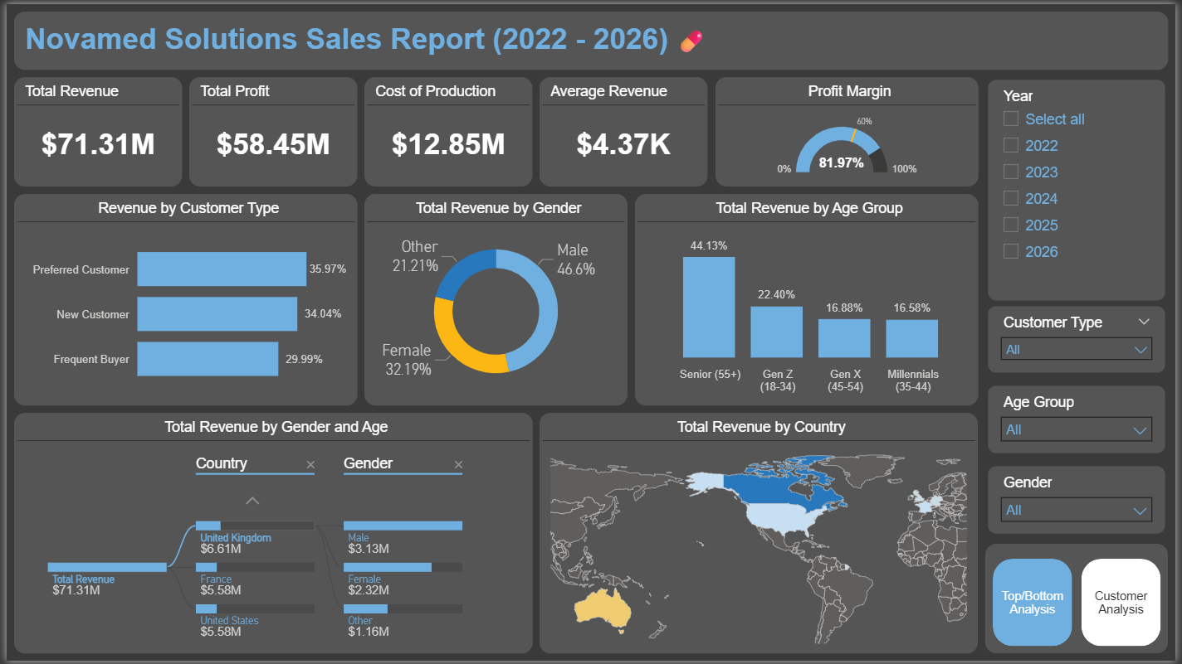
Customer Analysis Dashboard

Slide 11
Methodology
The SWOT framework (Strengths, Weaknesses, Opportunities, and Threats) has been utilized to evaluate the sales performance of NovaMed Solutions.
By integrating SWOT analysis with sales metrics and Power BI dashboards, we identify trends, highlight areas for improvement, and anticipate potential challenges that may impact operations.
This structured approach provides strategic insights beyond mere data, supporting informed decision-making to enhance business strategies and optimize overall performance.

Slide 12
SWOT Breakdown
Strengths:*Products such as Doxycycline and Lisinopril, which have the highest profit margins and the largest sales volumes, serve as core revenue drivers and significantly contribute to the company's profitability.
Weaknesses: Underperforming products like Amoxicillin and Fluticasone, which generate low revenue or possess low profit margins, hinder efficiency and indicate areas that require reevaluation.
Opportunities: Untapped markets and customer segments offer potential for revenue growth at relatively low costs. For instance, expanding into Australia and implementing targeted campaigns for Generation X frequent buyers could be a beneficial move.
Threats: External risks include rising costs of raw materials (COGS), declining selling prices, and a substantial drop in annual revenue, which fell from $5.19 million in December 2023 to a decrease of 59.18% in January 2024. These factors may place pressure on profit margins and overall competitiveness.

Slide 13
Insights Deep Dive Dimensions
Month-over-month comparison
Top 5 & Bottom 5 Drugs
Customer Performance
Customer Demographics
customer type

Slide 14

Top Bottom Analysis

Slide 15
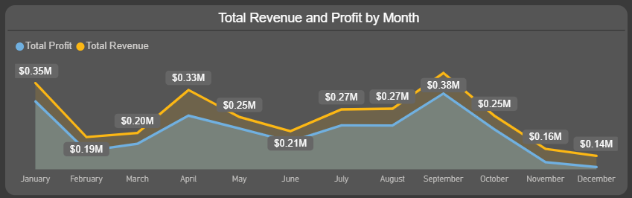
M-O-M comparison 2022
Revenue experienced a sharp decline of 45.04% from January to February.
There was a recovery in the following months, but June saw another drop of 16.65%.
From July to September, revenue rebounded; however, the year ended on a weak note, with December recording the lowest levels of both profit and loss.

Slide 16
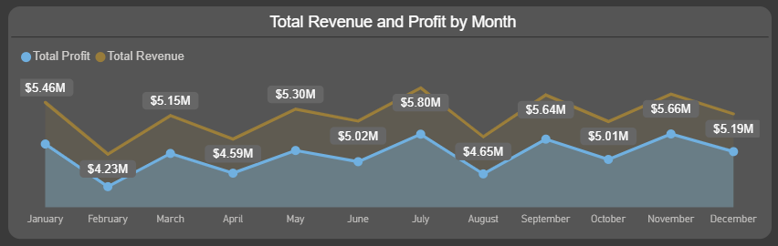
M-O-M comparison 2023
January started strong with a 3900.95% increase over December 2022, but February saw a significant decline of 22.43%.
Overall, revenue and profit showed steady growth throughout the year, with a notable dip in August at 19.94%.
December ended slightly negatively with an 8.30% decrease.

Slide 17
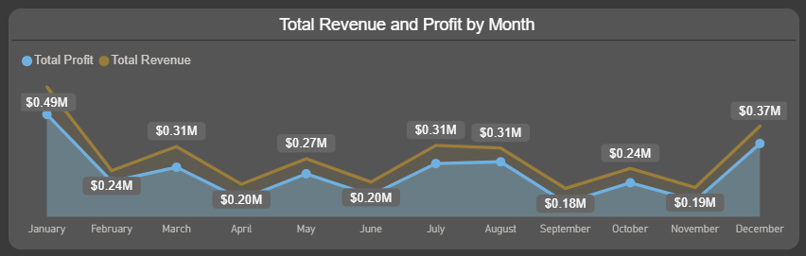
M-O-M comparison 2024
In January 2024, revenue fell by 59.18% from December 2023. December 2022 ended at $136.43K, while January 2023 surged to $5.46M, a 3900.95% increase, suggesting 2023 was atypical.
Revenue in 2024 has generally declined, with a slight growth of 55.12%, and a significant drop of 40.20% in September.
However, December 2024 rebounded strongly, reaching $372.82K, nearly doubling with a 99.99% increase.

Slide 18
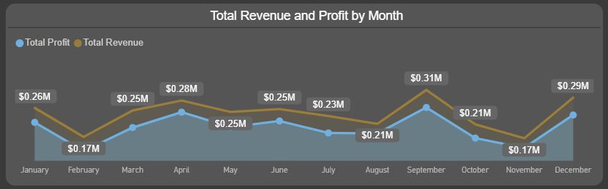
M-O-M comparison 2025
January started strong with a 30.89% increase; however, February experienced a significant drop of 33.98%.
Recovery was modest until mid-year, and after April, sales began to decline steadily, hitting their lowest point in November, although September saw a notable spike of 48.96%.
December ended the year with a remarkable 74.05% increase.

Slide 19
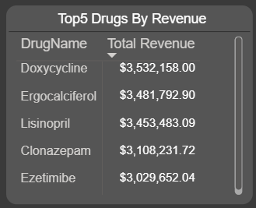
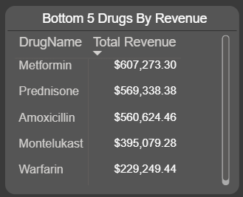
Top 5 & Bottom 5 Drugs
The top five selling drugs each generate over $3 million in revenue.
The combined revenue of the bottom five drugs is only $2.36 million, which is less than the revenue of any individual drug on the top five list.
All of the top five drugs have a high profit margin, exceeding 80%. Conversely, the bottom five drugs exhibit low profit margins, with Montelukast having the lowest at 8.34%. Notably, Prednisone has a profit margin of 77.85%.

Slide 20

Customer Performance

Slide 21
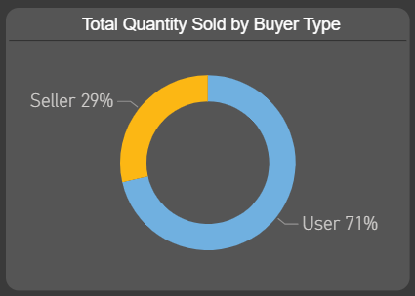
Customer Type
The majority of customers, in terms of quantity sold, were direct end users.
However, the customers who purchased the drugs for resale generated significantly higher revenue, totalling $62.86 million, compared to just $8.45 million from end users.
This indicates that while third-party sellers bought fewer drugs, their prices were considerably higher than those sold to end users.

Slide 22
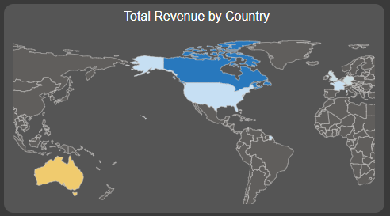
Location
On the map, dark blue represents the highest value, yellow mid-value, and light blue the lowest value.
Canada has become the strongest customer base, accounting for 44.41% of revenue from the region. Out of the $31.67 million in revenue from Canada, 51.12% was generated by male customers, with the majority being seniors.
Australia has the second-largest customer base, accounting for 21.39% of the total customer base. Although this region generates the second-highest revenue, its earnings are nearly half of Canada’s revenue. Additionally, 56.37% of the revenue comes from senior female customers.

Slide 23
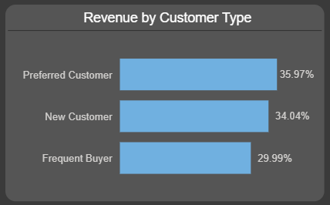
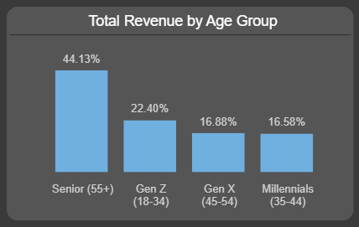
Age Group
The buying habits of different age groups show distinct patterns. While frequent buyers are consistently represented across all age groups, preferred customers and new customers tend to skew toward seniors.
Notably, only 19.76% of seniors are classified as frequent buyers, which contrasts with other age groups.
Generation X has the highest percentage of frequent buyers at 42.28%, and this group exhibits an even distribution of genders.
Millennials also show a strong tendency to make repeat purchases, with 38.02% being frequent buyers. In comparison, 34.92% of Generation Z buyers are frequent purchasers.

Slide 24
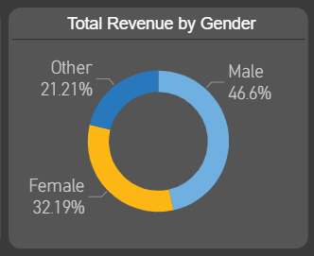
Gender
The data encompasses three gender categories: Male, Female, and Other. Among individuals in the "Other" category, 48.22% are new customers, with a significant number located in Canada.
Male customers generate the largest portion of revenue, accounting for 46.6% of total revenue. Within this group, 37.24% are preferred customers, with the majority residing in Canada and Australia.
Female customers primarily consist of frequent and preferred buyers. They are evenly distributed across various locations, with a substantial presence in Australia, followed by Canada and several European countries, including Germany, France, and the United Kingdom.

Slide 25

Recommendations

Slide 26
Revenue & Profit Optimisation
Introduce seasonal promotions or discount campaigns to stabilise sales throughout the year.
Bundle underperforming drugs like Amoxicillin with top performers like Doxycycline
Monitor turnover of low-demand drugs to minimise overstocking and reduce holding costs.

Slide 27
2. Top Drug Strategy
Secure long-term supplier agreements to ensure steady availability for top-selling drugs.
Invest in campaigns to enhance the market share of top-selling drugs.
Explore new drug categories aligned with top performer trends.

Slide 28
3. Customer Relationship Management
Reward top customers like Bob Williams with exclusive loyalty discounts.
Target underperforming customers (Carol Smith) with personalised offers.
Tailor campaigns by customer type and age group (e.g., incentives for Gen X frequent buyers).

Slide 29
4. Geographical Expansion
Strengthen presence by focusing on preferred senior male customers in Canada.
Expand campaigns targeting frequent senior female buyers in Australia.
Explore opportunities in regions with smaller but growing revenue streams in Europe.

Slide 30
5. Operational Efficiency
Leverage Power BI predictive models to align stock with seasonal demand.
Deploy real-time Power BI Service dashboards to track revenue, margins, and stock levels.
Set automated notifications to track low inventory of high-demand products.

Slide 31
6. Future Growth Opportunities
Utilize predictive analytics to forecast sales performance by drug and region.
Implement customer engagement tools, such as developing a mobile app or creating email campaigns informed by demographic insights.
Enhance e-commerce personalization by recommending products based on customers' purchase history, following best practices from leading retail platforms.

Slide 32

Assumptions & Caveats

Slide 33
Assumptions
This analysis accepted an assumption that:
The extremely high sales in 2023 are likely due to a partnership with another supplier, boosting revenue.
The conflicting relationship between CustomerID and Buyer Type (User or Seller) in the Fact table indicates how customers acquired the medicine. This is to maintain normalisation and prevent any ambiguity regarding transitive dependency, as it is essential to store Buyer Type as an attribute in the Customer table, as it is an inherent characteristic of the customer.
Duplicate SalesID entries had unique values in other columns, indicating a possible data entry error. An indexed SalesID column was created as a primary key for the Fact table.

Slide 34
Caveats
The Buyer Type in the Fact table may not fully represent customer behaviour due to normalisation issues. Therefore, insights derived from this field should be interpreted with caution.
The dataset does not account for market dynamics, supply chain disruptions, competitor actions, or regulatory changes, all of which could impact actual sales and profitability trends.

Slide 35
GitHub link to clone:
GitHub:
https://github.com/cephard/NovaMed-Solutions.git
Power BI Service:
https://app.powerbi.com/view?r=eyJrIjoiZTJmZDFmMTItMDc4Ni00YTQxLWFhMTAtYzZlZDc2ZWQ3MTJkIiwidCI6ImZmMGYzZTNhLTNlNTMtNDU0Zi1iMmI1LTZjNjg3NTNiOGVlNCJ9

Slide 36
Thank You!

